Slide 1

Containerisation 101
Tsholofelo Pole
Notes:
The buzzword Docker has been thrown around in a lot of teams, articles and conversations among developers;
But what is this technology that everyone seems so excited about?
Docker containerization is technology that makes it easier for teams to collaborate and deploy applications faster.
Docker can make teams very efficient and improve teams' ability to deliver software to many clients around the globe. Learning these technologies will prove to be beneficial for the informed developer.

Slide 2
Containerisation 101
Tsholofelo Pole
Notes:
The buzzword Docker has been thrown around in a lot of teams, articles and conversations among developers;
But what is this technology that everyone seems so excited about?
Docker containerization is technology that makes it easier for teams to collaborate and deploy applications faster.
Docker can make teams very efficient and improve teams' ability to deliver software to many clients around the globe. Learning these technologies will prove to be beneficial for the informed developer.

Slide 3


A bit about me
Intermediate Software engineer at Entelect
Mobile developer
“There is no such thing as too much sugar!!!”
Notes:
Interests:
Reading and writing
Podcast and chilling 😜
Nail enthusiast – collect nail polish
Philanthropy
Ways to use technology in education

Slide 4
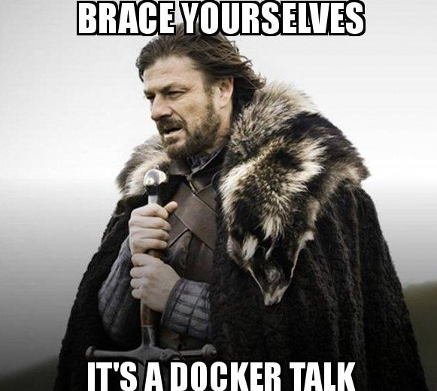
agenda
What is Docker?
Why use Docker?
What are containers?
The building blocks of your container
Create our own images
Run a few containers
Notes:
What is Docker?
Storytime: Why devs need to containerize software
Introduction to Docker
Docker vs VMs
Why use docker/benefits of using Docker

Slide 5


Once upon a time…
Our ways of working may have changed
But the processes remain the same
You are the tech lead on a team
New project
Architecture down for the project
Your have your champions
POC is up and running
But it’s on your machine
Notes:
I thought we’d start with a story that we are all familiar with, or I hope will experience at some point in our careers
Our ways of working may have changed
But the processes remain the same
You are the tech lead on a team
New project
Architecture down for the project
Your have your champions
POC is up and running
On your machine

Slide 6


Slide 7
What is docker?
An open-source project that automates the deployment of software applications inside containers by providing an additional layer of abstraction and automation of Operating System-level virtualization on Linux.

Slide 8
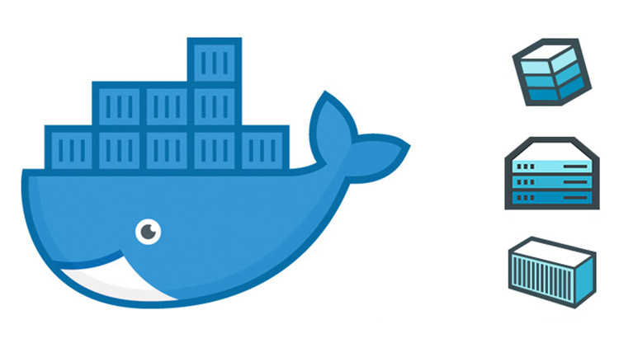
What is docker?
A tool that allows developers to package an application and its dependencies into a standardized units called containers
Notes:
Docker is an type of platform-as-a-service product that uses operating system level virtualization to deliver software in packages called containers
So in simple terms, Docker is a technology that can be used to build, package and run applications in containerized or isolated environments
A suite of tools to manage containers and not just a tool

Slide 9
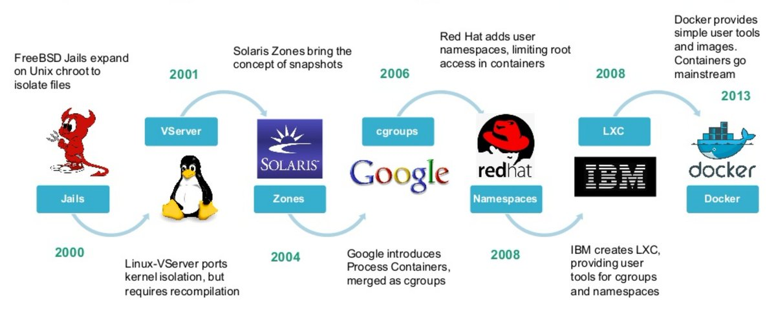
The history of docker
Notes:
Let’s start with understanding where containers came from, what they are designed to do and why they came about
1979: chroot: change root directory for a given process, helpful for builds and allowed you to isolate your process from the rest of the system
Jails: these allowed you to sign ip addresses to the jails
Solaris snapshot: read-only copy of a file system/volume
Google: process containers: features that would limit resources these processes could allocate, these were merged into the linux kernel as cgroups
2008: Linux Containers: name of the initial containers: uses cgroups and Linux namespaces to isolate the work group
These did not need any patching off the linux kernel
2013 – LMTCFY – Let me Containerise that for you – released just before Docker in 2013
Docker was more popular due to it’s ease of use
A suite of tools to manage containers and not just a tool

Slide 10
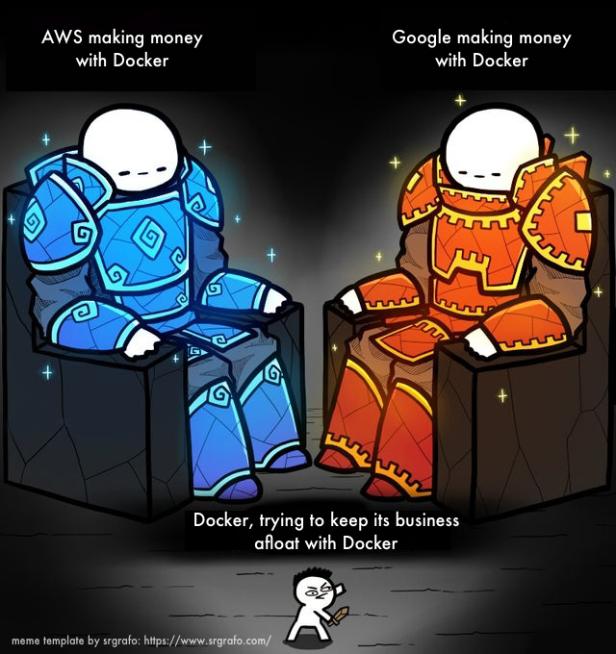
So… is it free?
Community edition and licensed features
Docker desktop is not free anymore
Free for personal use
Licensing for commercial use
Paid model offers a few more features
Security control and access
Does not affect running applications
Notes:
Docker created their own container orchestration platform "Docker Swarm."
the point of this tool was to make it so that you could launch containers on a fleet of services and easily manage them. This was their financial flagship that they expected to bring in cash and make good with their nearly $272+ million worth of investment.
But their competitors won out: Kubernetes and AWS ECS are some of these competing service
And Docker had financial problems
Docker Community edition includes the Docker engine and the docker commands
This is not changing the runtime engine, just the desktop
Docker d and container d are unaffected by this announcement
They are still free and open source
If your environment is running on ECS
Docker Desktop is free to use, as part of the Docker Personal subscription, for individuals, non-commercial open source developers, students and educators, and small businesses of less than 250 employees AND less than $10 million in revenue.

Slide 11
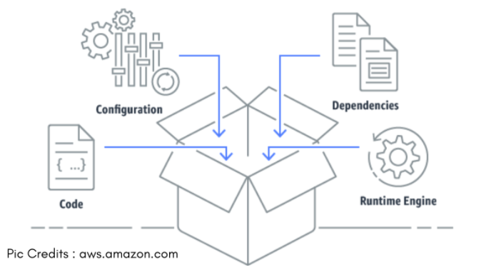
containers?
Instance of an image
Has an id and a state
A container is the isolated environment running our application
You can run multiple containers on a single host
They don’t have to be running the same content/project
Low level: set of processes that are isolated from the rest of the system
Notes:
And image can be thought of as a software package and the container the installed instance of that software
A container consists of: a docker image, an execution env and a set of instructions.
Container states: created, restarting, running, removing, paused, exited and dead and it doesn’t need to be running
container -> installed instance of that software
A container contains: a docker image, an execution env and a set of instructions.
a container is basically an image that is running in your host OS. A Docker container containerized (wraps) an application’s software into an invisible box with everything the application needs to run. That includes the operating system, application code, runtime, system tools, system libraries, and etc.
An example of this is to start your container, ssh into it and run a command that normally works on your host but is not installed in your container

Slide 12
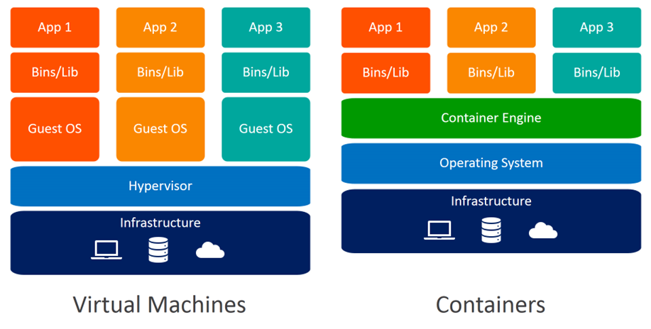

Containers vs vms
Notes:
Virtual machines
A VM isolates an entire system and has its own resources.
Each VM has its own OS, making each VM take up a lot of space
Docker
With Docker, the kernel will share the resources of the host system. Docker is not a VM but in terms of use, can be related to a VM.
All containers share the same OS
A partnership between Docker Inc and Microsoft helped make Docker accessible to most OSs.

Slide 13
Benefits of containers

Slide 14
Why use Docker?
Containers are independent of their host
They are lightweight
Host OS and resources are shared
No provisioned RAM for applications
Use when required basis
Versioning and testing of software is much easier
Notes:
Containers are independent of their host
The host system does not affect how your containers work
Interaction with containers is identical across multiple hosts
PC, private clouds or public clouds remains the same
shared across multiple people and the container’s behavior will be the same across the many hosts, and interaction with the containers does not change
Containers are very lightweight
As the containers share the same host and resources, they are very lightweight, lighter than VMs
Containers take milliseconds to start up
Containers share the same host OS
- Containers do not package the OS but the applications and its dependencies
- A single host can run multiple containers
No provisioned RAM – use when required
Versioning of software is much easier
- Tag versions of images for feature work
Easy to test different versions and makes rollbacks much easier as a tagged image can be used in case of broken builds/releases
Side note: you can run multiple containers with an identical application as long as each one binds to its own port:
containers cannot share ports/access points

Slide 15
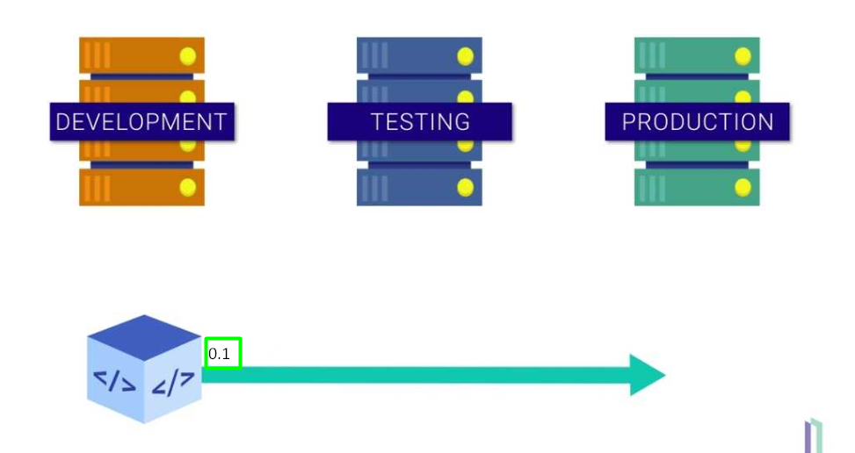
Testing our applications is easier

Slide 16

More benefits
Containers are fully portable
Code, dependencies, configuration, etc.
Simple configuration
Containers can be integrated into existing infrastructures
Notes:
Fully portable – code, dependencies, libraries etc.
Simple configuration – Dockerfile
Containers can be integrated into existing infrastructures
Corporates with existing VM infrastructure can integrate Docker into their existing infrastructure
Changing applications’ infrastructure and architecture is not easy as this is something that would have been built over a long time

Slide 17
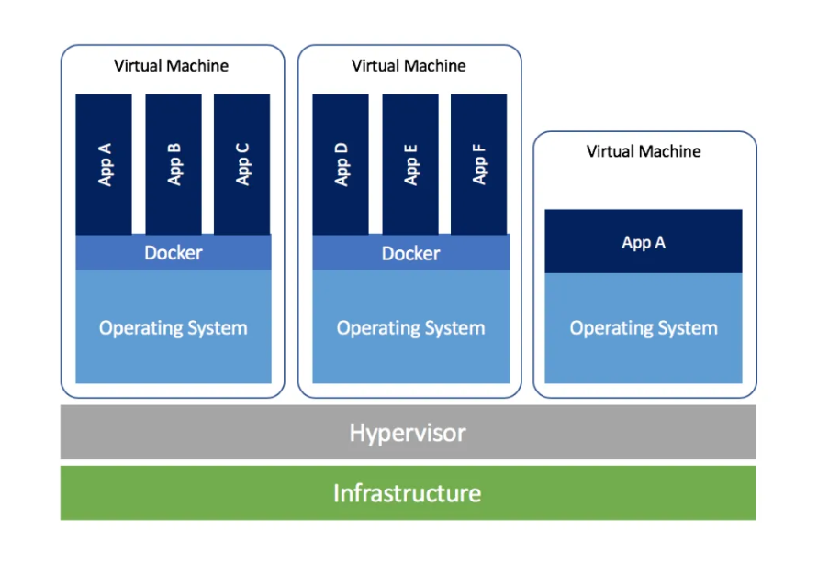
Containers can be integrated into our existing infrastructure

Slide 18
Terminology

Slide 19
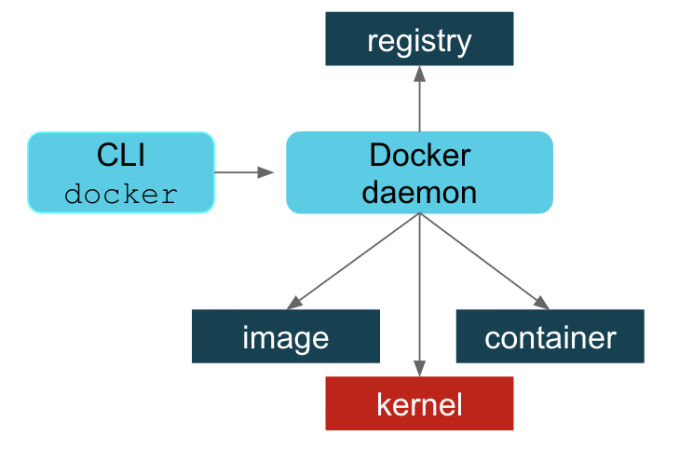
Docker daemon
A background service running on the host
Listens for Docker API requests
Notes:
Docker Daemon - The background service running on the host that manages building, running and distributing Docker containers. The daemon is the process that runs in the operating system which clients talk to
Listens for Docker API requests and manages images, containers, networks
Acts like the brain of Docker

Slide 20
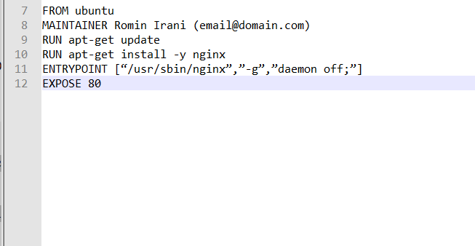
dockerfiles
A text document that contains a list of commands
The Docker client calls these commands when creating an image
Docker can build images by reading instructions from a Dockerfile
Notes:
A Dockerfile is a text document that contains all the commands you would manually execute to build an image.
Docker can build images by reading instructions from a Dockerfile.
A container consists of: a docker image, an execution env and a set of instructions.
A Dockerfile is a text document that contains all the commands you would manually execute to build an image.

Slide 21

images
A blueprint of a container
An image does not have a state
Images can be used to create other images
A single image can be used to start many containers
An image == class
Container == an object of that class
Notes:
And image can be thought of as a software package and the container the installed instance of that software
A single image can spin up multiple containers, as long as they have different names, and bind to different ports
Images are read-only templates that you build from a set of instructions written in your Dockerfile.
Images define both what you want your packaged application and its dependencies to look like *and* what processes to run when it’s launched.

Slide 22
containers
Instance of an image
Has an id and a state
A container is the isolated environment running our application
You can run multiple containers on a single host
Low level: set of processes that are isolated from the rest of the system
Notes:
And image can be thought of as a software package and the container the installed instance of that software
A container consists of: a docker image, an execution env and a set of instructions.
Container states: created, restarting, running, removing, paused, exited and dead and it doesn’t need to be running
container -> installed instance of that software
A container contains: a docker image, an execution env and a set of instructions.
They don’t have to be running the same content/project
a container is basically an image that is running in your host OS. A Docker container containerized (wraps) an application’s software into an invisible box with everything the application needs to run. That includes the operating system, application code, runtime, system tools, system libraries, and etc.
An example of this is to start your container, ssh into it and run a command that normally works on your host but is not installed in your container

Slide 23
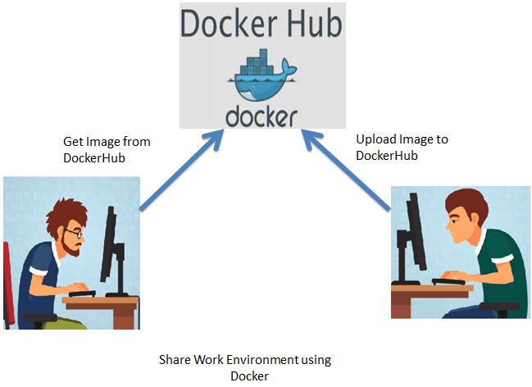
dockerhub
Cloud based registry service
Allows you to upload and download Docker images
Notes:
Docker Hub is a registry service on the cloud that allows you to download Docker images that are built by other communities. You can also upload your own Docker built images to Docker hub

Slide 24
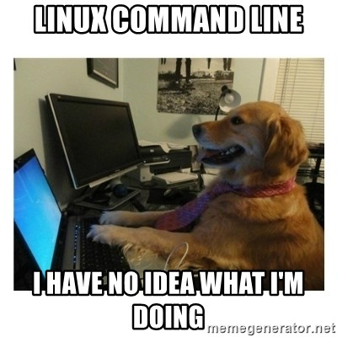
commands
DOCKER
docker pull
docker images
docker run
docker ps
docker stop {{container_id}}
docker restart
docker rmi

Slide 25
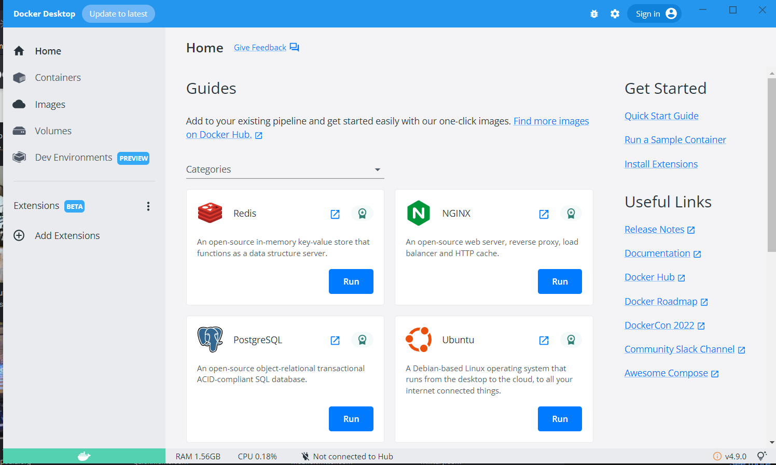
Docker desktop to get started
Notes:
But remember that this is not free for commercial use
Kitematic is a good alternative

Slide 26
Hello world
docker pull hello-world
docker images
docker run hello-world

Slide 27
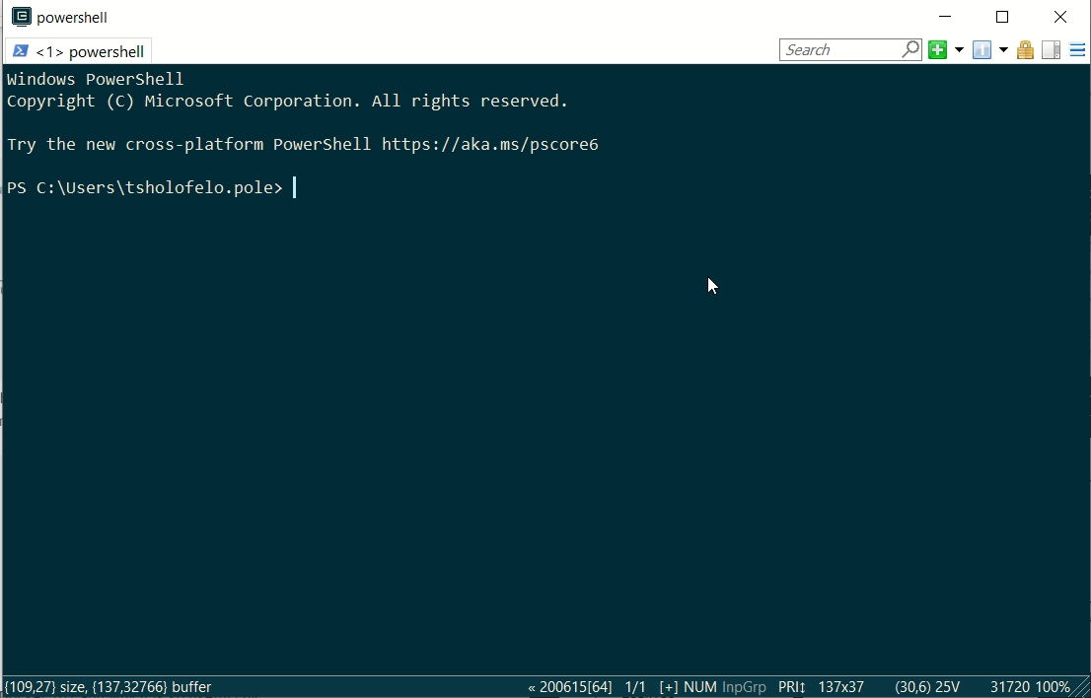
Hello from Docker
Running a hello world container

Slide 28
Now let’s access our containers
Notes:
When our containers we will not have access to them on our host unless we bind some ports to our local machine
This is where port binding comes in, we need to make sure we can access our containers, from our host

Slide 29
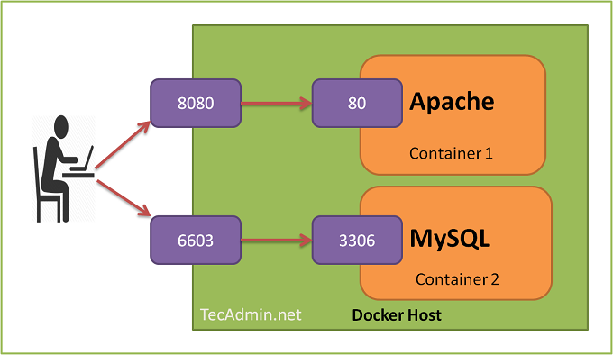
Port bindings
We need to access our isolated application in some way
Every container exposes some ports
This gives us access the running application in the container
Link a container port to a port on your host
You can still run multiple containers, they just can’t all be accessed on the same port
Notes:
Then all the requests that are made to the host port can be redirected into the Docker container.
Each container needs to have a unique name

Slide 30
Run an nginx container
Download the nginx image from DockerHub
docker pull nginx
Run a container using this image
docker run --name nginx-demo -d nginx
Run another container, but bind ports to our host
docker run --name nginx-demo –d -p 80:80 nginx
Notes:
docker run --name nginx-demo -d nginx
-> --name: what we want to name our container
-> nginx: name of the image we want to run
docker run --name nginx-demo -d -p 80:80 nginx
-> 80:80 : bind port 80 in the container to port 80 on the host

Slide 31
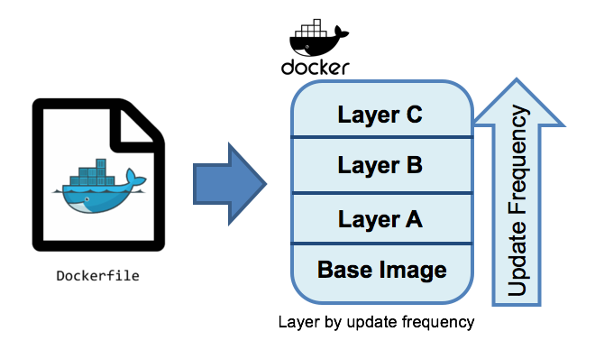
Docker images
Lets us build our very own image
Frequent updates
Bottom of your Dockerfile
Top of your Dockerfile
Infrequent updates
Notes:
Images do not have a state, but they can be used to build other images
Remember that your image is a set of commands that can be used to run a container
When we went through our Dockerfile
Every command adds a layer and every time we run docker pull
Only updated layers will be pulled
Dev teams can have dtandards/processes
- Everytimedevelop or master is updated, a new image would be built and tagged with the new date/version

Slide 32
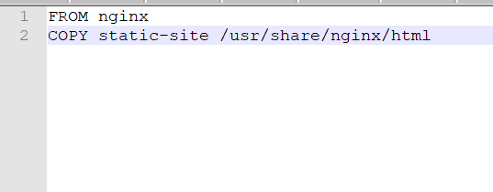
Create an image
Add these two lines to your nginx dockerfile
FROM nginx
COPY static-site /usr/share/nginx/html
Notes:
tells docker to use the nginx image
Because I didn’t specify a version for our nginx image, docker will pull the latest one
Copies the static-site folder to the specified location in our image

Slide 33
Run a container from our image
Let us build the image
docker build -t my-nginx-image .
Let’s run a container from our image
docker run --name my-static-site -d -p 81:80 my-nginx-image

Slide 34
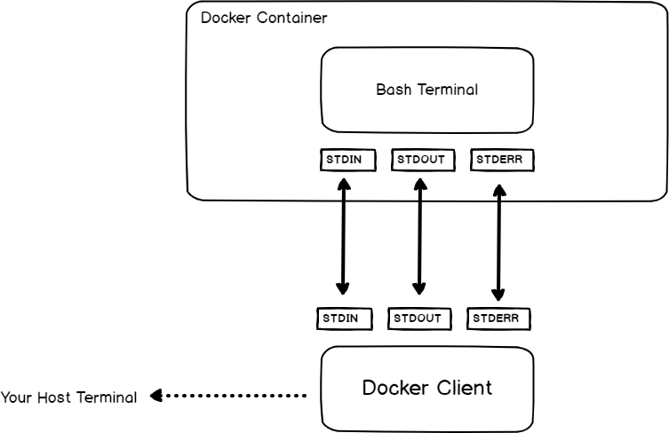
Docker exec
A command
Execute commands within the container
docker exec –it {{container_id}} /bin/bash
Let’s make a small update to the hosted content
Get into our container
Update our html file
Notes:
Docker exec is a command that allows the execution of any given command within a Docker container. This means it will interpret the arguments passed to it as commands to be run inside the container
After making changes to our container content, we may want to persist this data for the next time we test our application
Data generated by your container is not persistent, it will be lost when you stop your container
There are alternatives to this: and create an image from your container and tag it
But this is not a stable process, we need a safe location for the data our container uses

Slide 35
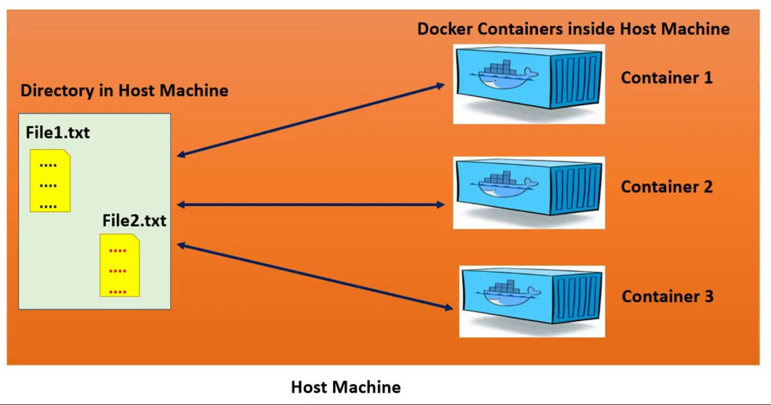
volumes
File systems mounted on containers
These preserve data generated by your containers
This allows us to keep data between runs
These can be added when starting the container
Multiple containers can mount a shared volume
Notes:
Docker volumes are file systems mounted on Docker containers to preserve data generated by the running container.
Remember the data generated by your containers is not persisted and will be deleted when you stop your containers
It is also very difficult to get data out of the container if another process needs it or if you need to restart the container and reuse that data
An example: hosting your web site in a separate location to your containers, this can be a service, an s3 bucket which is on the cloud
An example of this: running a postgres db in your container and having to restart the containers, you don’t want to lose the data you have persisted to the db

Slide 36
Lets add some volume
We can start our nginx container with a volume
Our container will read from the volume and update if the content changes
No container restarts required
docker run -v path_to_folder:container_location:rw -p 82:80 -d nginx
Notes:
Docker volumes are file systems mounted on Docker containers to preserve data generated by the running container.
The location we mount does not have to be on our host
It can be a location hosted somewhere else

Slide 37
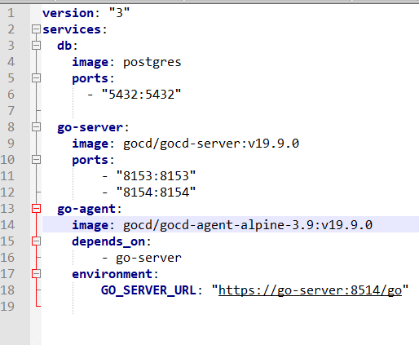
Docker compose
Defining and running multi-container applications
Written in YAML
Single command => running multiple containers
Notes:
Compose is a tool for defining and running complex apps with Docker.
The applications’ structure, setup and requirements will be defined in a single file, then a single command will be used to spin up the application and does everything required to get the application running

Slide 38
?
?
Questions
?

Slide 39
Get in touch
Slack: @tsholofelopole
Email: tsholofelo.pole@entelect.co.za
References?
https://docs.docker.com/get-started/overview/
https://www.baeldung.com/ops/docker-volumes
https://www.youtube.com/watch?v=rOTqprHv1YE

